Slide 1
NAHR CHRO Academy XXI
June 9, 2022
Session 9
New Expectations for Corporations,
the Greater Focus on Environmental, Social and Corporate Governance (ESG)
and the Opportunity for HR
Marcia Avedon
Dan Yager
Tracy Keogh
Notes:
Libby
Thank everyone for joining, express excitement to be presenting on ESG today with a great panel
Each speaker introduce themselves
Transition: We’ve been looking forward to sharing our thoughts ESG, expectations for corporations and the opportunity for HR – but more importantly also interested in hearing your thoughts as well in a discussion.

Slide 2
Today’s agenda
What do we mean by ESG?
What is the role of CHROs?
What are key stakeholder expectations and how are they changing?
Impact of governmental and regulatory environment
What the best-in-class companies are doing
Mini-case example
Corporate Sustainability
Notes:
Marcia

Slide 3
What is ESG?
ENVIRONMENTAL (E)
SOCIAL (S)
GOVERNANCE (G)
Climate change
Energy
Water
Materials
Biodiversity
Emissions
Waste and pollution
Remediation
Supply chain
Culture
Diversity & equal opportunity
Product / Customer health & safety
Employee safety & well-being
Labor / Management relations
Human capital
Reskilling, upskilling, education
Community engagement
Human rights / stakeholder rights
Privacy & security practices
Public policy
Rewards & wages
Ethical business practices
Anti-corruption
Anti-competitive behavior
Management approach
Board composition
Executive compensation
Economic performance
Risk management
Procurement practices
Reference: GRI Reporting Standards https://www.globalreporting.org
What is Sustainability?
Notes:
Marcia
Reference board role

Slide 4
Roles and Challenges: The “S” in ESG
ENVIRONMENTAL (E)
SOCIAL (S)
GOVERNANCE (G)
Climate change
Energy
Water
Materials
Biodiversity
Emissions
Waste and pollution
Remediation
Supply chain
Culture
Diversity & equal opportunity
Product / Customer health & safety
Employee safety & well-being
Labor / Management relations
Human capital
Reskilling, upskilling, education
Community engagement
Human rights / stakeholder rights
Privacy & security practices
Public policy
Rewards & wages
Ethical business practices
Anti-corruption
Anti-competitive behavior
Management approach
Board composition
Executive compensation
Economic performance
Risk management
Procurement practices
Reference: GRI Reporting Standards https://www.globalreporting.org
What is Sustainability?
Notes:
Marcia
Linking HR Strategy to business strategy
CHROs and compensation expectations / metrics & discussion around what great looks like, implications

Slide 5
What are expectations from stakeholders today?
Safety, diversity, equity expectations
Data security and privacy
Connection with company purpose
Culture of Care
Employee Well-being
Learning and development
Flexible work
Inclusion
Net zero expectations, carbon prices
BoD governance
Executive pay
Lobbying
Renewable energy R&D focus
EMPLOYEES
REGULATORY & GOVERNMENT
Safe travel confidence
Rising environmental justice focus
Public – private partnerships
Inequality concerns
Community outreach and volunteering
Climate change risk focus
SEC increasing attention; consistency
Carbon offset markets maturing
Company resilience and crisis management
Employee retention
Supply chain ethics
CUSTOMERS &
COMMUNITIES
INVESTORS
How has trust changed?
Notes:
Marcia

Slide 6
METRICS USED TO MEASURE CORPORATE SUSTAINABILITY
How are companies measured for sustainability?
PRINCIPLES & RATINGS
Product safety & reliability
Employee health & safety
Ethical business practices
Economic performance
Diversity & Inclusion
Labor & employee relations
Education & training
Greenhouse gas emissions
Community impact
Materials management
Water use
Energy management
Waste reduction
Supply chain practices
LEADING ASSESSMENT PROVIDERS
Corporate Sustainability
Notes:
Marcia

Slide 7
Who Will Solve These Problems?
Global Warming
Wealth Gap
Gender & Racial Pay Equity
Leadership Representation
Work/Life Balance
Workplace Harassment
Health Care Disparities
Racial & Ethnic Tensions
LGBTQ Discrimination
Data Privacy
Gig Economy Safety Net
Reproductive Freedom / Rights
Corporate Sustainability
Notes:
Marcia turn over to Dan
Paradigm shift on how policy is done > away from the government
Holistic view

Slide 8
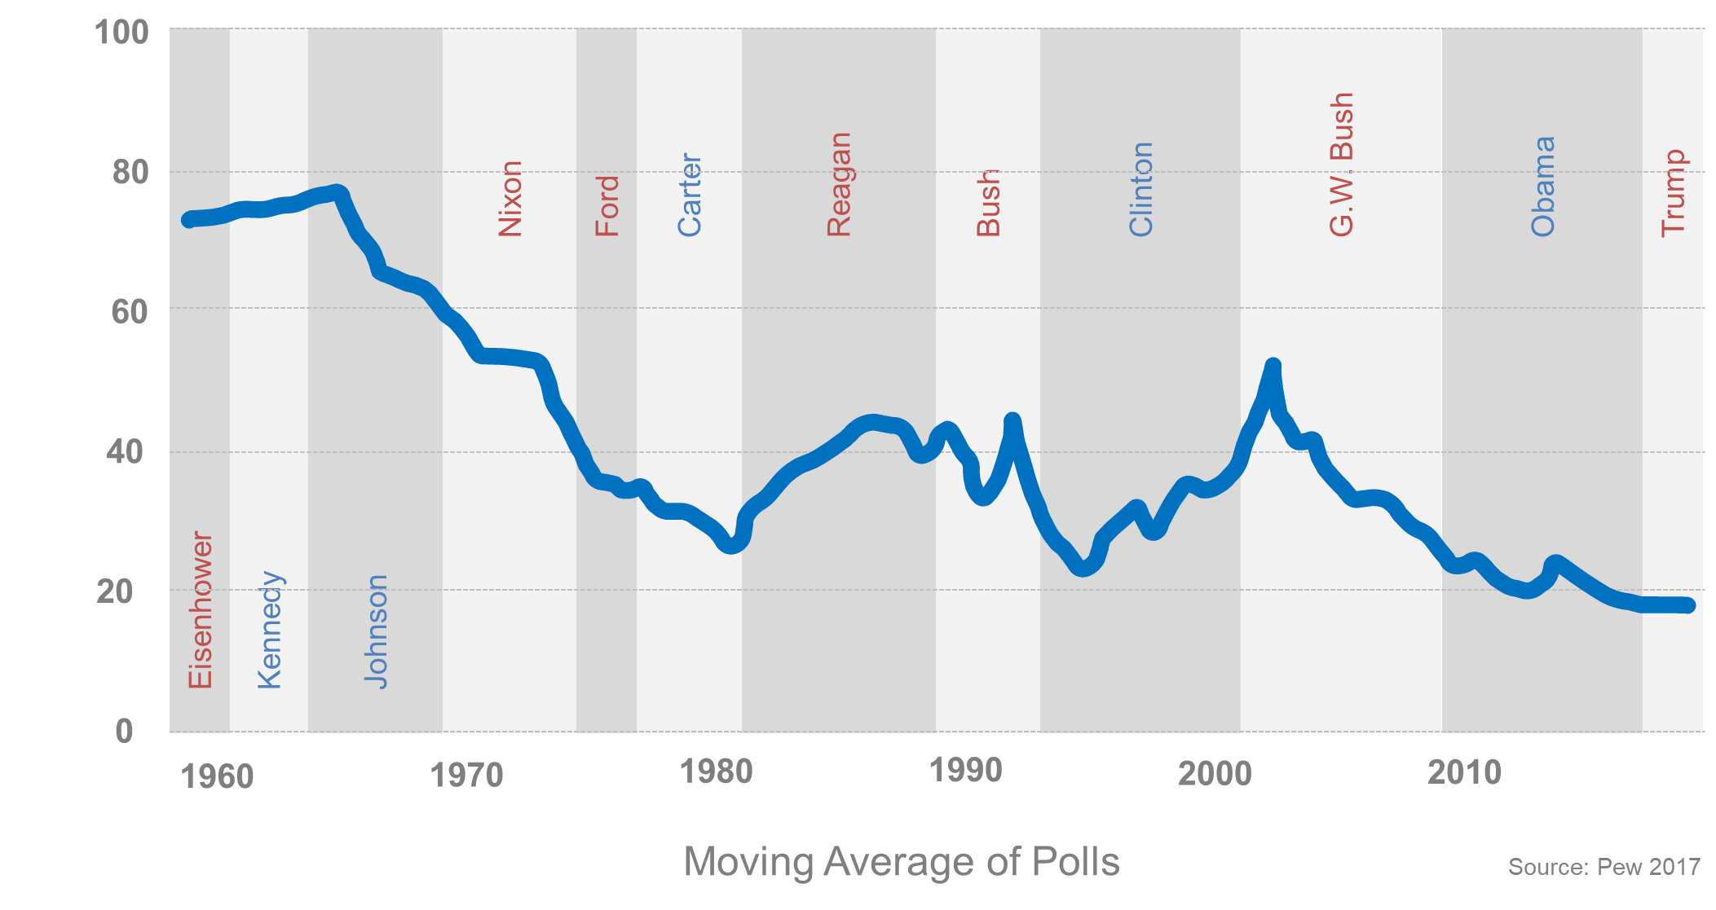
How has trust changed?
Percent Who “Trust Government Most of the Time”
How has trust changed?
Notes:
Dan
Confidence in business increased, surpassing all other

Slide 9
Of the 100 largest economies in the world, 48 are publicly traded global corporations
17
39
58
69
79
93
18
40
59
70
81
94
19
42
60
71
82
95
20
44
61
72
83
96
28
52
64
73
88
97
29
54
65
75
89
98
31
55
66
76
90
99
32
56
67
77
91
100
9
Notes:
Dan

Slide 10
Biden Administration initiatives
Securities & Exchange Commission
Expected to propose rules requiring disclosures of climate and human capital metrics, such as
Workforce turnover
Skills and development training
Compensation/benefits
Workforce demographics including diversity
Health and safety
Proposed rules governing investment funds claiming ESG focus, including new disclosure requirements regarding measure of progress (May 2022)
Department of Labor
Proposed rule allowing (and potentially requiring) pension fund fiduciaries to consider ESG factors in investments (“social investing”) (October 2021)
Reversal of Trump DOL interpretation: “promotion of ESG does not necessarily result in a prudent investment”
Notes:
Dan
https://www.wsj.com/articles/sec-to-propose-more-disclosure-requirements-for-esg-funds-11653498000

Slide 11
What are companies doing today?
Recognized as one of the worlds most sustainable companies
Ambitious goals set and overseen by Board of Directors
“We aim to be the most sustainable and just technology company”
Focus on Planet, People, Community
Sustainable Impact fully integrated into all aspects of business
Created the most sustainable portfolio of products – launched more than 300 products using recycled plastic since 2017
2.8M pounds of ocean-bound plastic used in HP products in the past 5 years
Achieved zero deforestation associated with HP brand paper and paper-based product packaging in 2020
Accelerating digital equity for 150 million people globally by 2030
Leadership held financially accountable for Sustainable Impact goals
What are companies doing today?
Notes:
Tracy

Slide 12
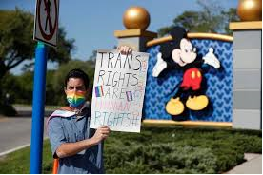
Mini case study
BACKGROUND
3/2022 – Florida Gov. DeSantis signed Parental Rights in Education (“Don’t Say Gay”) bill (H.B 1577) prohibiting teaching in the third grade and below about gender identity and sexual orientation
After harsh vocal response from employees for not publicly opposing the bill, Disney CEO Bob Chapek apologized and condemned the new law
DeSantis responded by signing a bill eliminating Disney’s special tax and self-ruling status in central Florida
DISCUSSION
Breakout into table teams
Spend 20 minutes discussing:
What are some other options Disney could have considered?
In the current situation, what do they do now?
Notes:
Facilitated by Tracy
Break into groups
Discuss missteps & what happened
Q&A during breakout session

Slide 13
Key takeaways
CHRO plays a major role in ESG working with CEO, colleagues, and the Board of Directors – “a team sport” with many players and significant reputational capital at stake
Stakeholders are looking to companies to address ESG issues and authentically align ESG strategy to business strategy – what is important to your company and why?
Anticipate various stakeholder (employees, customers, etc.) reactions to legislation or events before they happen and conduct scenario planning
Consider all stakeholders when making a statement – follow company values to avoid “taking sides”
Not commenting is a statement and not without consequences
Notes:
Marcia

