Slide 1

The Modern HR Mindset: Creating a Culture That Leaves Your People and Organization Net Better Off
Lucien Alziari
NAHR Director & NAHR Fellow
EVP & Chief Human Resources Officer, Prudential Financial Inc.
Daniel Marsili
NAHR Director & NAHR Fellow
Former Chief Human Resources Officer, Colgate-Palmolive Company
Christy Pambianchi
NAHR Foundation Vice Chair & NAHR Fellow
EVP & Chief People Officer, Intel
NAHR CHRO Academy XXI
Thursday, June 9
Session 7
Notes:
Welcome! Thrilled to be here in-person at the NAHR Academy & celebrating 30 years of NAHR!
<Introduce panelists>
Today we’re going to discuss the Modern HR Mindset: Creating a Culture that Leaves your people and organization better off
I am going to start with a few slides on findings from a study that Accenture commissioned in collaboration with Marriott International on this topic. Accenture CHRO Ellyn Shook unfortunately couldn’t be here with us, but I’m excited to share the findings with you on her behalf.
After that, we’ll jump right into Q&A with our panel on how they’ve approached culture and human potential in their roles as CHRO.

Slide 2

CARE
TO DO
BETTER
Building trust to leave your people and your business net better off
In conjunction with Marriott International
Notes:
The name of the study is Care to do Better.
The study started in 2020 when the world was turned upside down by the COVID-19 pandemic. The research is based on a comprehensive survey of 3,200 C-Suite executives, half of which were HR decision makers and over 15,600 workers spanning 15 industries and 10 countries.
At the heart of many conversations at the start of the pandemic and today is the question: How can we take care of our people?
Today’s CHROs have the opportunity to reclaim one of our most fundamental missions: the care and resiliency of human workers. We are able to rewrite a script that builds trust based on the fundamentals of what matters most to their people.
And according to this research, leaving people better off is not only the right things to do – it’s the right things for your business. Let’s dive in.

Slide 3

Responsible businesses
will have the pick of the talent
Roughly 1 in 2 workers agree that the ethical, sustainable and moral values that a company holds will become more important to them personally after the pandemic passes.
An important step forward on that path is to reframe the role of the CHRO and nurture a new kind of relationship for people to have with their work and employer.
Copyright © 2020 Accenture. All rights reserved.
3
Notes:
The research found 1 in 2 workers believe that ethical, sustainable, moral practices of companies matter to people. We found this during the pandemic.
And as a CHRO you may benefit from thinking through how this translates to programs you design, ways you engage workers and ultimately the broader community.

Slide 4
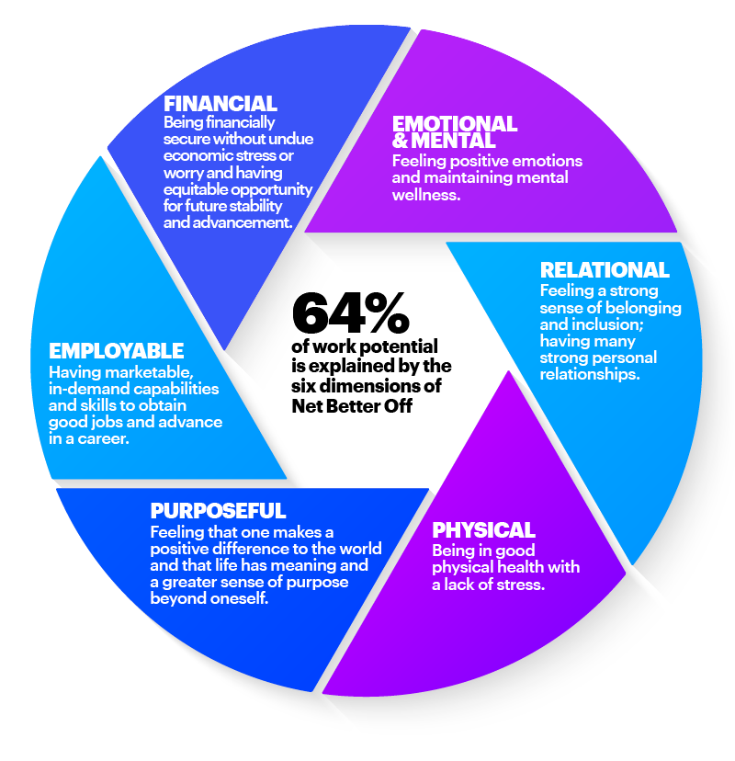
Introducing a ground-breaking new model:
Net Better Off
By meeting six fundamental human needs through work, companies can unlock their people’s full potential. We call this framework “Net Better Off”.
Net Better Off measures and brings into focus what inspires workers’ potential.
We found that each of the six dimensions of net better off were significantly correlated with people trusting their employer.
4
Notes:
Accenture asked one big question in this research. What matters most to people at work so that they can bring their best each day?
They found through extensive research 6 unique dimensions that matter most to people and account for 64% of their potential
At Intel, we are focused on all six of these dimensions to attract, engage and retain talent.
For example, we have introduced programs and benefits since the start of the pandemic to support emotional/mental well-being, including wellness days off and access to resources/applications that support mental health. We are also focused on connecting our employees with our purpose, which is to create world-changing technology that improves the life of every person on the planet.

Slide 5
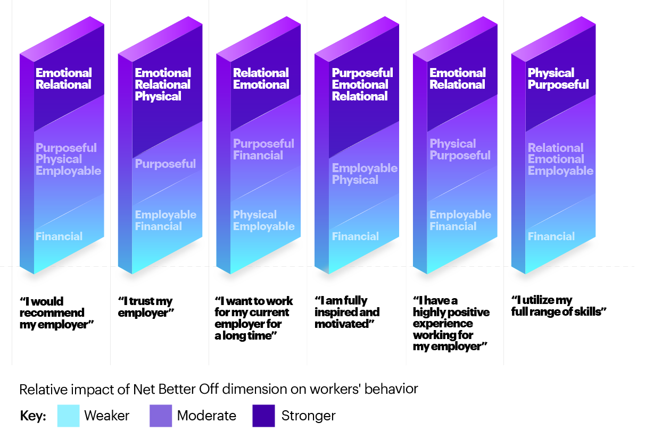
The strongest drivers of worker behavior are attributed to
the Relational
and Emotional dimensions of Net Better Off
Notes:
With the Net Better Off model identified, next Accenture wanted to know which dimensions drive human behavior in the workplace.
Research shows that the C-suite feels most responsible for the financial and employable dimensions, but that is not what accelerates people’s performance in the workplace.
Relational, emotional/mental needs are the biggest drivers of a person’s potential at work, and during COVID, physical needs rose in importance.
Yet, most employers are investing only in financial and employable – which is a missed opportunity.
Eva to ask Tim, Anthony: What did you think of these findings? Any surprises here? Each to speak on their experience and perspectives

Slide 6
Ask Us Anything

Slide 7
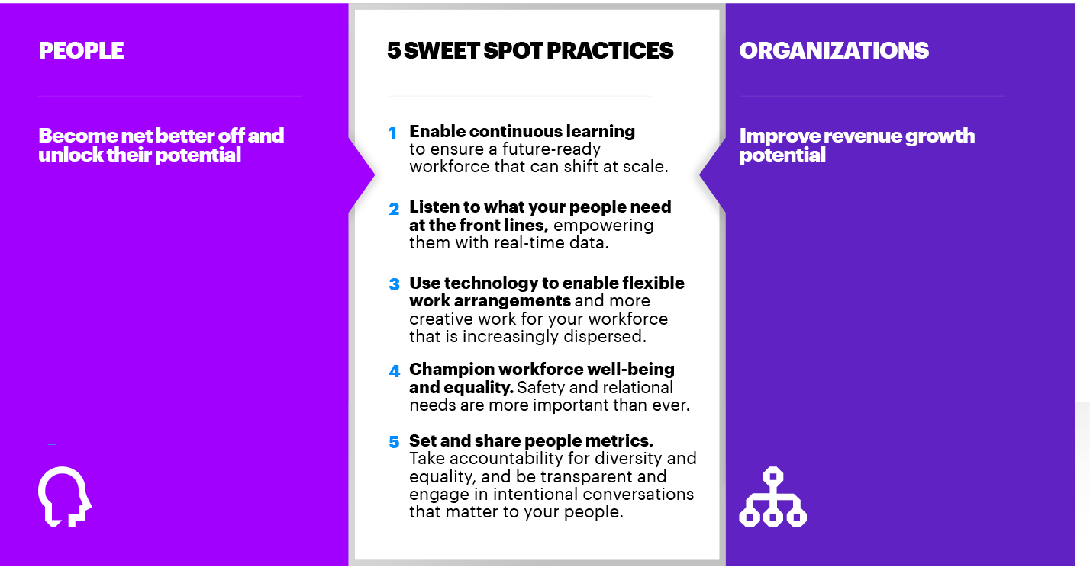
In Closing: Five sweet spot practices
Through statistical testing of more than 20 business practices, we’ve identified five Sweet Spot Practices that are sure to maximize results and pay dividends for both individuals and the organization.
Notes:
To close out, I’d like to share the tangible actions that leaders can take to meet employees’ needs – to lift your people and boost business performance.
These are the 5 sweet spot practices (started with 20…) that serve as a bridge to positive, tangible outcomes.
<read five practices>

Slide 8

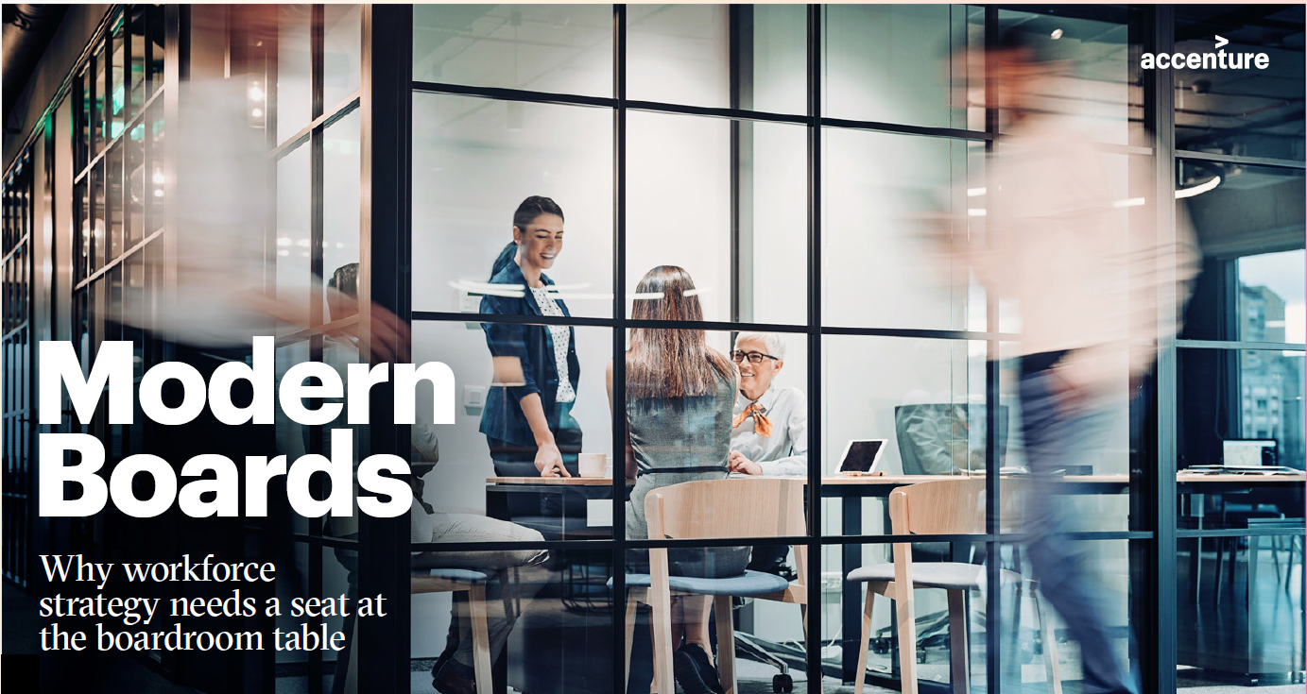
Tools from the session
Care to do better research report
Modern Boards Research report

Slide 9
Backup

Slide 10
And Modern Boards are focused on…
Critical workforce elements and act on data to improve capabilities
Workforce metrics most commonly
discussed among Modern Boards are
related to talent and attraction, wellness and resiliency,
and workforce data.
52.5%
56.2%
48.9%
Talent and attraction
Wellness and resiliency
Workforce data
Notes:
There is hope and opportunity for traditional boards to quickly evolve to become Modern Boards with the curiosity, passion and drive to lead their organizations into the future, while managing risk in this uncertain world.
Transformational leadership and boards need to be the early adopter groups to keep pace with the new world in which we live. This era marks an opportunity to do better and enable the business to thrive.
Accenture’s research shows that Modern Boards are tackling tough workforce topics that elicit public scrutiny, for instance, pay equity, inclusion and diversity, and workforce reduction plan.

Slide 11
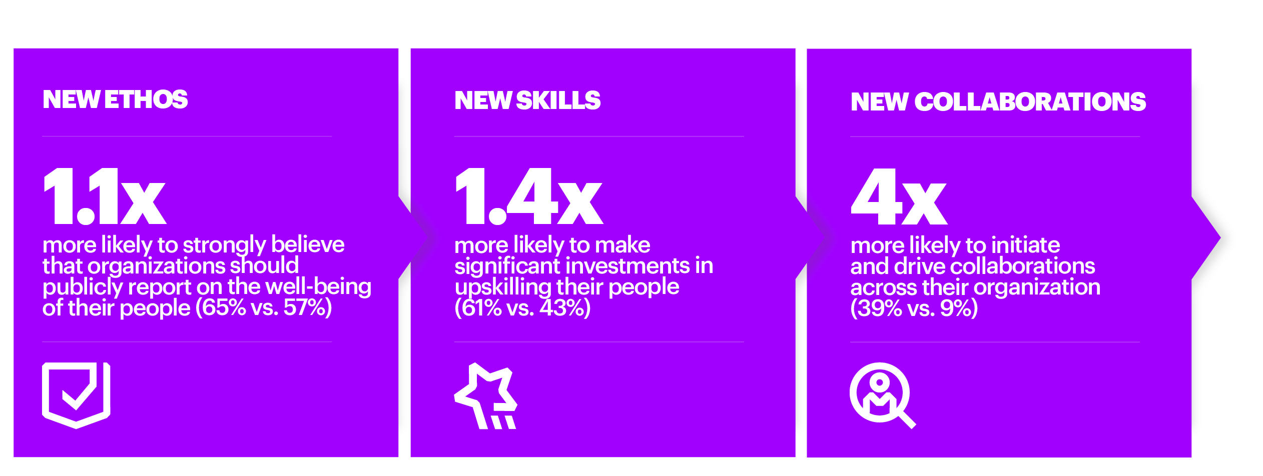
Secrets of success for modern HR
We found three ways in which HR trailblazers approach their work differently than their peers in other organizations.
TRANSPARENCY
Yet within our study we found that less than 20 percent of organizations are modern HR leaders.
Notes:
The last part of Accenture’s research turns back to the HR function to learn how HR leaders can lead differently in order to leave their people net better off.
They found a couple of key insights.
Biggest finding is the ethos and focus on people, business and community. This ties back to the earlier conversation on purpose. HR trailblazers are 1.1x more likely to strongly believe that organizations should publicly report on the well-being of their people (65% vs. 57%)
3 new types of skills and roles for HR in the future: Steward of purpose, upskilling advocate and Work Technologist. HR trailblazers are 1.4x more likely to make significant investments in upskilling their people (61% vs 43%)
Lastly, new types of collaborations forming in the HR community. HR trailblazers are 4x more likely to initiate and drive collaborations across their organization
As we move from pandemic to endemic and enter the future of work, HR trailblazers will serve as a significant competitive advantage for companies.

