Slide 1
HR Strategy and Operations
Global Supply Chain Refresh
March 2022
Dick Antoine, Marcia Avedon, John Murabito, Perry Stuckey

Slide 2
Integrated Cascade of Choices
Business Strategy
Human Capital & Talent Strategy
Strategic Execution and Alignment
Metrics and Analytics (Accountability)
2

Slide 3
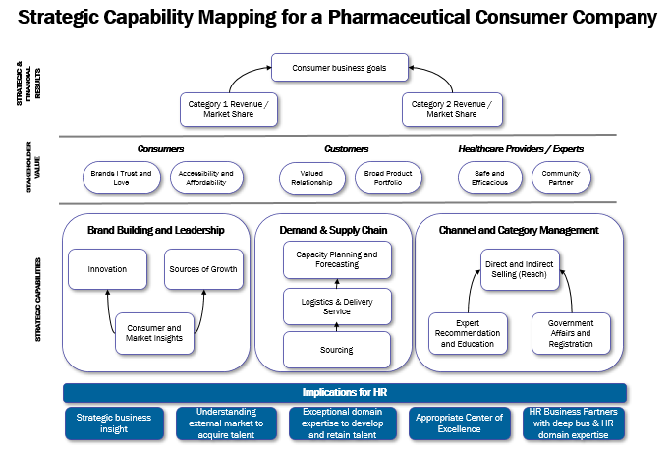
How it “all fits together” – Company Example
What strategic and financial outcomes does our Company need to deliver?
What value do our key stakeholders expect from us?
What capabilities and culture are required to deliver value to our stakeholders and achieve our strategic and financial outcomes?
3

Slide 4
BUSINESS STRATEGY HUMAN CAPITAL and TALENT STRATEGY
Where to Play
How to Win
4

Slide 5
Strategic Execution and Alignment
Global Supply Chain Refresh
March 2022

Slide 6
Outcomes of Effective HR Strategy Execution
Purpose
Clarity of Purpose: Ensuring linkage to the company business purpose and higher-order strategic goals through goal cascade process and ongoing communications.
HR understands how they create value!
People
Building the HR organization capabilities/talent to have “the functional domain expertise” to deliver functional excellence required for company strategy
Top HR organizations are focused on continuous improvement, critically evaluating where their value is optimal and where they need improvement. Methods to obtain stakeholder feedback exist.
Resources are consistent with the requirements to deliver your company business strategy – be willing to make trade-offs and prioritize.
Process
Payoff
Delivering real and consistent value to the enterprise and all stakeholders
Demonstrating “Functional Excellence” for other functions in the organization
Creating an HR Organization that is a desired place for top talent to come and to stay.
6

Slide 7
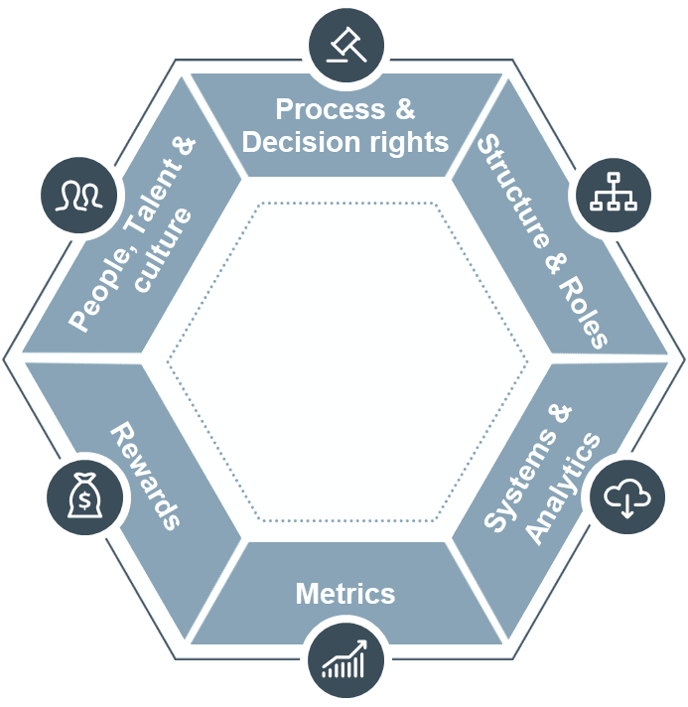
Comprehensive Strategy Execution is an Ongoing Expectation for CHROs to Demonstrate, Teach and Coach
Top Ten Reasons Strategies Fail (Forbes)
Having a plan simply for plans sake
Not understanding the environment or focusing on results
Partial commitment
Not having the right people
Writing a plan and putting it on the shelf
Unwillingness or inability to change
Having the wrong people in leadership positions
Ignoring marketplace reality, facts, and assumptions
No accountability or follow through
Unrealistic goals or lack of focus and resources
Strategies change and evolve as a function of environment and aspirations
The one thing competition cannot replicate is your people and culture
Biggest sources of failure are capability and culture
If you don’t have the right capabilities for your strategy, you’re playing pretend
7

Slide 8
Developing the “Critical HR Domain Expertise” for Functional Excellence
Business Dedicated – e.g., Dedicated HR Partners to drive business growth.
Unique HR Domain Expertise required to enable a business’s strategic people success and financial outcomes (e.g., Human Capital Business Partner)
Centers of Excellence/Expertise – Specialized talent required to enable multiple businesses and functional success (e.g., Organization Effectiveness, Total Rewards)
HR Operations or Shared Services, Enabled by Technology – The talent required to ensure the basic HR tools, processes and systems are effective and efficient (e.g., benefits administration, time and attendance, payroll, etc.)
Third Party Assistance – HR Talent “on-loan” including gig workers, or third-party HR vendors to the business to handle ad hoc needs, such as potential M&A, special projects, etc.
A holistic HR Model is required with appropriate knowledge and skills that works together to create business value
8

Slide 9
Discussion Questions
Do you have the critical HR Domain Expertise that is needed to deliver on your business strategies?
Where are there opportunities to improve?
How do you continue to evolve the HR Delivery Model to add more value – more effectiveness and efficiency? What training, systems, processes or tools are needed?
Do you have a leadership team that is aligned to deliver the value required to be a premier HR organization?
9

Slide 10
Metrics, Scorecard & Analytics
Global Supply Chain Refresh
March 2022

Slide 11
Measurement is key to your strategy and operations
Modern HR requires data and analytics
Drives strong decision making and the right solutions
Combine learnings for the best insights
Know your investment needs based on data
Justify requested investments
Connect your metrics to your particular business and strategy
Scorecard what you choose to measure
What you choose to measure should tell you if you are achieving your strategy’s goals

Slide 12
At Cigna we dove deep into five basic areas
Employee Perspective
Turnover
Diversity
Succession
Talent Management
Measured at various intervals depending on the metric
Sourced generally from Workday and Employee Surveys
Measured against annually-set goals for all metrics

Slide 13
Employee Perspective
Employee Net Promoter Score
Simple - do you recommend your company to family and friends?
Employee Commitment Index
A composite of survey questions on Motivation, Leadership, Strategy, Belonging, Community and Career Mobility
On Feeling Valued
On Change
Is my company willing to make change to compete?
Does the company manage change well?

Slide 14
Turnover
All the Basics of course …..
Total, US, non-US, by level, exempt/non-exempt, women, all the ethnic minorities; and then combinations of these.
And then a number of “special” looks ……
Employees with potential, employees with less than one year of service,
exempt employees who changed roles,
top quartile bonus recipients,
active leadership program participants,
graduates of leadership programs
Combinations of these turnover metrics allow for powerful and insightful analytics

Slide 15
Diversity
Representation
Total, by level, by each ethnic minority group, women, and at senior levels; and then combinations of these
“DEI Index”
A composite of seven survey items designed to assess sentiments regarding DEI
Questions like “My company values and promotes diversity”, “Employees of all backgrounds can succeed at my company”, “My manager encourages diversity and inclusion”, etc.
For positions considered “critical” to the business
What percentage are held by women?
What percentage are held by ethnic minorities?

Slide 16
Succession
Executive positions with at least 1 Ready Now successor
Executive positions with no successor
Percent of (any particular level) with potential to be promoted
Percent of (any particular level) on at least one succession plan

Slide 17
Talent Management
Percent of external hires sourced through referral
Annualized percent of exempt employees who changed roles
Percent of bonus eligible roles filled internally
Percent of hiring managers claiming they would hire the same person again
Rewards - ratio of average top quartile bonus award to average of all bonus awards

Slide 18
Good Analytics
Start with good data
“Combine” metrics for insights
Take the time to formulate good questions - what would be impactful to know?!
Hire real Data Scientists to do the work
Involve Leadership beyond HR
If you can measure it, you can manage it…

Slide 19
Things on the horizon to stay engaged and focused on

Slide 20
Potential Securities and Exchange Commission Regulation
Will require more specific data vs previous “principles based” approach
Will likely be four areas of specific data required:
Workforce Composition (including Contractors)
Total Employee Costs - comp, benefits, training
Turnover
Diversity
Move toward generally accepted HC measures, a la GAAP
And we should only expect this to get broader …..
Pay equity, employee engagement, representation by level, etc.

