Slide 1
How Does
  THE HUMAN CAPITAL and HR STRATEGY support the Business Strategy?
  Dick Antoine
  Bill Allen
  Mara Swan/Eva Sage-Gavin

Slide 2
BUSINESS STRATEGY HUMAN CAPITAL and HR STRATEGY
Where to Play
How to Win

Slide 3
The One Page Strategy
Mission/Purpose:
Vision:
Objective:
Goals:
Strategies:
Plans:
Why do we exist?
The ten year view of what we hope to accomplish.
What success looks like in 3 years.
The key metrics (TSR, Revenue, Profit, Share, Cash).
The business choices we have made.
What capabilities and management systems are needed?
Who is accountable?
How will we measure success?

Slide 4
P&G North America Laundry Strategy 1990’s
Unilever
All # 1
P&G
Bold
Bonus
Cheer
Dash
Dreft
Era
Gain
Ivory Snow
Tide
Others
Arm & Hammer
Persil
Purex

Slide 5
P&G North America Laundry Strategy
Drive Tide and Make Cheer #2
  through Product Superiority and Superior In Store Presence
Implications for HR
  Strategy Deployment
  R&D capability
  Sales capability

Slide 6
Translating Business Strategy to HR Strategy
Bill Allen, CEO Works

Slide 7
Two of the most important jobs that a CEO is responsible for are the allocation of capital and the allocation of talent.
Frank Blake
Former Chairman & CEO at The Home Depot

Slide 8


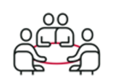
KNOW THE POINTS OF LEVERAGE FOR VALUE CREATION
BUSINESS STRATEGY
THE WORK
THE ROLES
Define the sources of value, today & tomorrow.
What needs to get done, in the most critical areas, to achieve the strategy.
The roles that have an out-sized impact on delivering the work.
THE ALIGNMENT
A cohesive leadership team on who and what will deliver the value agenda.

Slide 9
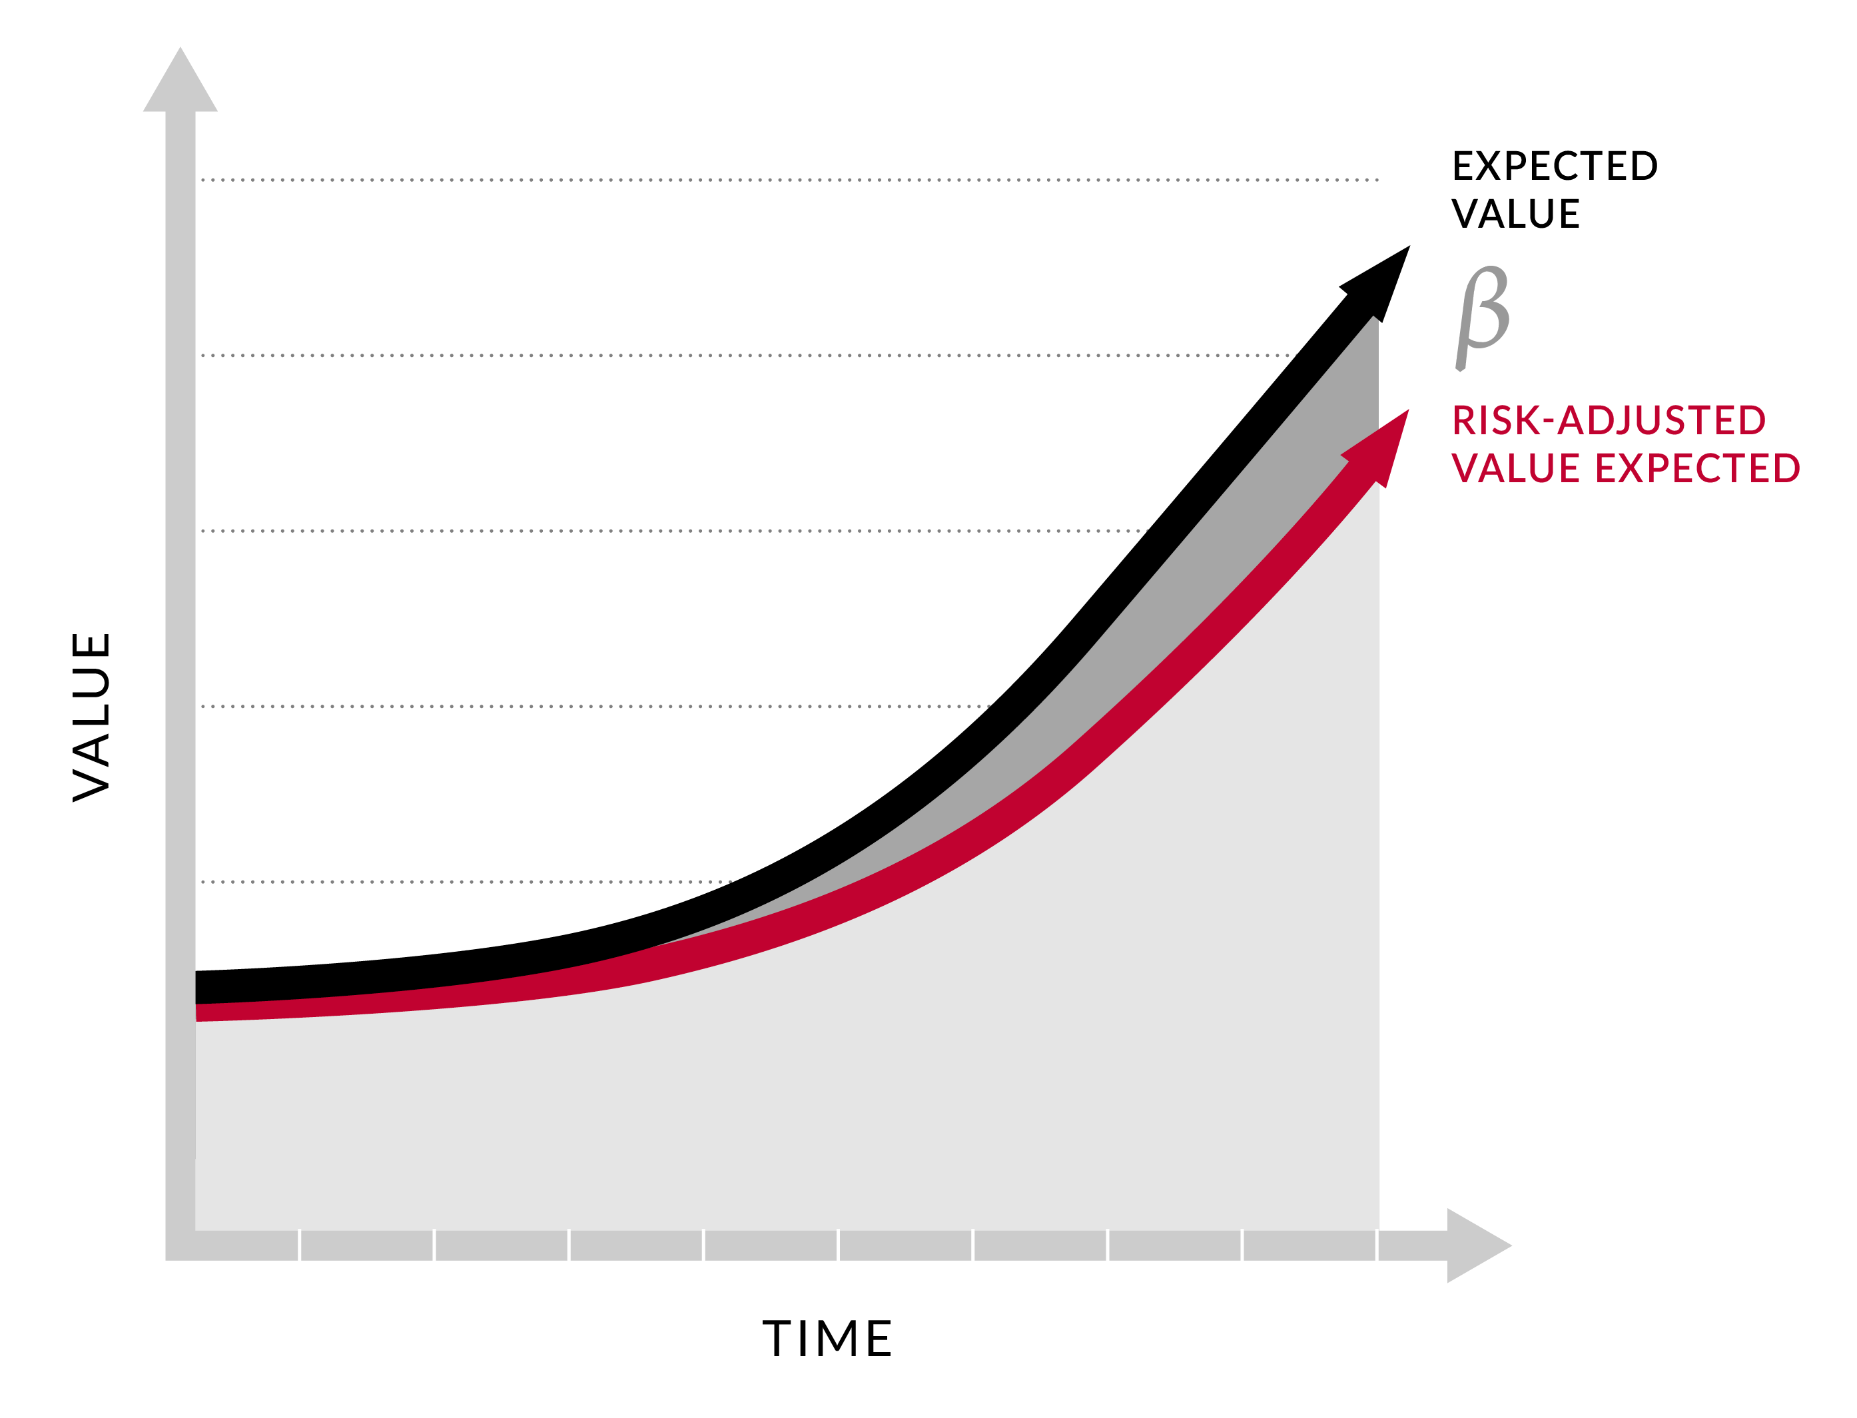
BUSINESS STRATEGY & HR EXECUTION RISK
Expected Value
Value at Risk
Risk-Adjusted Value Expected
Assess the Talent
Identify the Roles
Align on the Work
Know the Strategy
The Click

Slide 10
Business Strategy Human Capital and HR Strategy
In your breakout groups please discuss the following and be prepared to share with the group:
What is the KEY driver of your business strategy?

Slide 11
Business Strategy Drives People Strategy and HR Plan
01
Understand Enterprise strategy and connection to Business / Function Strategies, external trends, competition
Trends
Business strategy
01
02
02
Enterprise people capabilities
Identify future skills the workforce needs to be able to win in any environment
Business
strategy
Enterprise people capabilities
03
Understand the gaps between where the organization is today and where it needs to go, through external and internal lenses
06
03
Gaps & implications
Governance & monitoring
Data-led insights
Gaps & implications
04
Design People Strategy & HR Plan
Translate the org ambition into People Strategy and HR Plan with deliverables
05
Implementation
Execute strategy across various phases, utilize test and learn method
05
04
06
Governance & monitoring
Establish regular measurement to ensure progress and adapt strategy as needed
Implementation
Design People Strategy
and HR Plan
Copyright © 2021 Accenture. All rights reserved.

Slide 12

Unilever
Hyper-speed: How the hand sanitizer business adapted to meet global demand
Unilever went from producing ~700,000 items a month in January 2020 to producing around 100,000,000 items and increased production capacity worldwide by more than 600 times in tonnage.
Within 24 hours of the news of the Covid outbreak Unilever set up a fully empowered squad from brand teams, supply chain, R&D and Unilever international. They contacted multiple third parties and increased from two to 57 third-party partners located all over the world.
To move so quickly Unilever first had a very clear purpose and then agreed upon a framework that gave them the right teams the freedom to make decisions fast and deploy expertise where needed.
Copyright © 2021 Accenture. All rights reserved.

Slide 13

Best Buy
Flexible workforce
Best Buy’s flexible workforce initiative gives employees an opportunity to learn new skills and broaden their experience. The initiative allows employees to work in different departments/roles and also gives team members the potential for working different shifts or earning a different hourly wage depending on the tasks being performed. For example, a computing specialist can take a shift in the mobile department either because they wanted the cross-training or because the company needed extra labor in that department.
Best Buy hopes to develop employees and drive operational efficiency in labor planning and costs through additional scheduling, eligibility and flexibility.
Copyright © 2021 Accenture. All rights reserved.

